Slide 1
Splunk Technology Deck
Splunk Overview
Machine Learning Tour
Security Use Cases

Slide 2
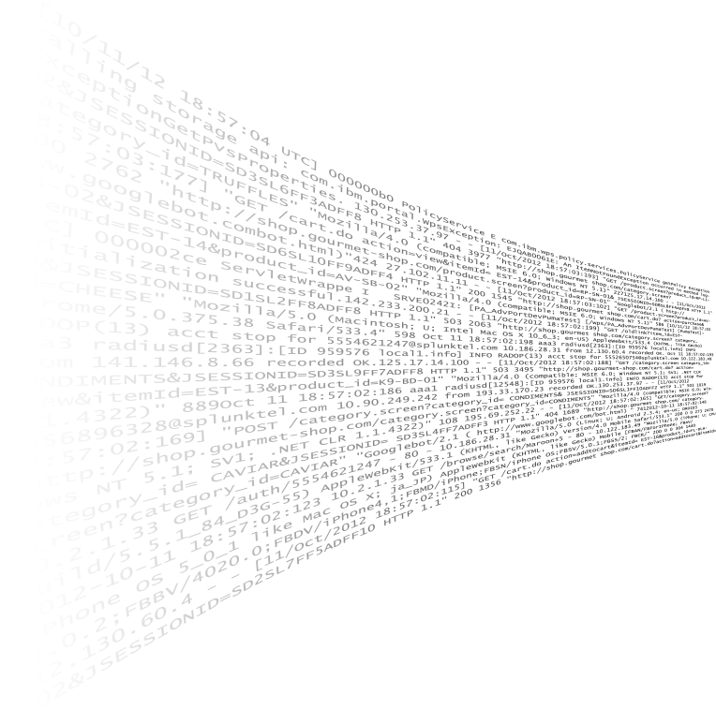


Continuous Data Ingest at Scale
Engineers
Data Analysts
Security Analysts
Business Users
Industrial Data
SCADA, AMI, Meter Reads
Industrial Assets
Native Inputs
TCP, UDP, Logs, Scripts, Wire, Mobile
Real Time
Search
Alert
Visualize
Predict
Develop
Consumer and Mobile Devices
Modular Inputs
MQTT, AMQP, COAP, REST, JMS
HTTP Event Collector
Token Authenticated Events
External Lookups/Enrichment
OT
Technology Partnerships
Kepware, AWS IoT, Cisco, Palo Alto
Asset Info
Maintenance Info
Data Stores
IT
Notes:
Getting data into Splunk is designed to be as flexible and easy as possible. Because the indexing engine is so flexible and doesn’t generally require configuration for most machine data generated by all of the devices, control systems, sensors, SCADA, networks, applications and end users connected by industrial networks. There are many options:
Splunk can directly monitor hundreds or thousands of local files, index them and detect changes. Additionally, many customers use our out-of-the-box scripts and tools to generate data – common examples include performance polling scripts on *nix hosts, API and more.
You can onboard data directly from any application or device– opening up new types of machine data to the benefits of Splunk analysis. The Event Collector makes it simple and efficient to collect this data, scaling to millions of events per second, using a developer-friendly, standard HTTP/JSON API and logging libraries
The HTTP Event Collector (EC) uses a standard API and high-volume Splunk endpoint to allow events to be directly sent/collected at extreme velocity. The data volumes supported by Splunk are ideal for IoT and industrial data.
There are many free add-ons and Apps for Splunk software that simplify the connection and collection of data from both industrial systems and the Internet of Things. These include:
Protocol Data Inputs: Recieve data via a number of different data protocols such as TCP , TCP(s) ,HTTP(s) PUT/POST/File Upload , UDP , Websockets , SockJS.
Rest API Modular Input: Poll local and remote REST APIs and index the responses.
Amazon Kinesis Modular Input: Index data from Amazon Kinesis, a fully managed service for real-time streaming data.
Apache Kafka Modular Input: Index messages from Apache Kafka messaging brokers, including clusters managed by Zookeeper.
DB Connect 2: Integrate structured data sources with your Splunk real-time machine data collection.
MQTT Modular Input: Index messages from MQTT, a machine-to-machine connectivity protocol, by subscribing Splunk software to MQTT Broker Topics.
AMQP Modular Input: Index data from message queues provided by AMQP brokers.
JMS Modular Input: Poll and index message queues and topics from messaging queues and topics, including MQTT messages, provided by message providers, including TibcoEMS, Weblogic JMS and ActiveMQ.
COAP Modular Input: Index messages from a COAP (Constrained Application Protocol) Server.
SNMP Modular Input: Collect data by polling SNMP attributes and catching SNMP traps from datacenter infrastructure devices providing cooling and power distribution.
Splunk App for Stream: Capture, filter and index real-time streaming wire data and network events.
Splunk isn’t the only technology that can benefit from collecting machine data, so let Splunk help send the data to those systems that need it. For those systems that want a direct tap into the raw data, Splunk can forward all or a subset of data in real time via TCP as raw text or RFC-compliant syslog. This can be done on the forwarder or centrally via the indexer without incrementing your daily indexing volume. Separately, Splunk can schedule sophisticated correlation searches and configure them to open tickets or insert events into SIEMs or operation event consoles. This allows you to summarize, mash-up and transform the data with the full power of the search language and import data into these other systems in a controlled fashion, even if they don’t natively support all the data types Splunk does.

Slide 3
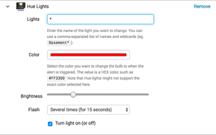

Sense and Respond
Every Search Can Use
Machine Learning
Flash lights
Industrial Assets
Send an email
Email
Consumer and Mobile Devices
Real Time
File a ticket
Search
Alert
Tickets
OT
Trigger process flow
Third-Party
Applications
Send a text
IT
Smartphones and Devices
Notes:
Getting data into Splunk is designed to be as flexible and easy as possible. Because the indexing engine is so flexible and doesn’t generally require configuration for most machine data generated by all of the devices, control systems, sensors, SCADA, networks, applications and end users connected by industrial networks. There are many options:
Splunk can directly monitor hundreds or thousands of local files, index them and detect changes. Additionally, many customers use our out-of-the-box scripts and tools to generate data – common examples include performance polling scripts on *nix hosts, API and more.
You can onboard data directly from any application or device– opening up new types of machine data to the benefits of Splunk analysis. The Event Collector makes it simple and efficient to collect this data, scaling to millions of events per second, using a developer-friendly, standard HTTP/JSON API and logging libraries
The HTTP Event Collector (EC) uses a standard API and high-volume Splunk endpoint to allow events to be directly sent/collected at extreme velocity. The data volumes supported by Splunk are ideal for IoT and industrial data.
There are many free add-ons and Apps for Splunk software that simplify the connection and collection of data from both industrial systems and the Internet of Things. These include:
Protocol Data Inputs: Recieve data via a number of different data protocols such as TCP , TCP(s) ,HTTP(s) PUT/POST/File Upload , UDP , Websockets , SockJS.
Rest API Modular Input: Poll local and remote REST APIs and index the responses.
Amazon Kinesis Modular Input: Index data from Amazon Kinesis, a fully managed service for real-time streaming data.
Apache Kafka Modular Input: Index messages from Apache Kafka messaging brokers, including clusters managed by Zookeeper.
DB Connect 2: Integrate structured data sources with your Splunk real-time machine data collection.
MQTT Modular Input: Index messages from MQTT, a machine-to-machine connectivity protocol, by subscribing Splunk software to MQTT Broker Topics.
AMQP Modular Input: Index data from message queues provided by AMQP brokers.
JMS Modular Input: Poll and index message queues and topics from messaging queues and topics, including MQTT messages, provided by message providers, including TibcoEMS, Weblogic JMS and ActiveMQ.
COAP Modular Input: Index messages from a COAP (Constrained Application Protocol) Server.
SNMP Modular Input: Collect data by polling SNMP attributes and catching SNMP traps from datacenter infrastructure devices providing cooling and power distribution.
Splunk App for Stream: Capture, filter and index real-time streaming wire data and network events.
Splunk isn’t the only technology that can benefit from collecting machine data, so let Splunk help send the data to those systems that need it. For those systems that want a direct tap into the raw data, Splunk can forward all or a subset of data in real time via TCP as raw text or RFC-compliant syslog. This can be done on the forwarder or centrally via the indexer without incrementing your daily indexing volume. Separately, Splunk can schedule sophisticated correlation searches and configure them to open tickets or insert events into SIEMs or operation event consoles. This allows you to summarize, mash-up and transform the data with the full power of the search language and import data into these other systems in a controlled fashion, even if they don’t natively support all the data types Splunk does.

Slide 4


Splunk: Data Fabric
IT Users
Analysts
Biz Users
Analysts
Biz Users
Industrial Assets
Ad hoc Search
Monitor and Alert
Reports/ Analyze
Custom Dashboards
ODBC SDK
API
Real Time
Consumer and Mobile Devices
Data Warehouses
DB Connect Look-ups
OT
Structured Data Sources
Clickstreams
Devices
Networks
Hadoop
CRM
ERP
HR
Billing
Product
Finance
IT
GPS/ Cellular
Servers
Applications
Online Shopping Carts
Notes:
Getting data into Splunk is designed to be as flexible and easy as possible. Because the indexing engine is so flexible and doesn’t generally require configuration for most machine data generated by all of the devices, control systems, sensors, SCADA, networks, applications and end users connected by industrial networks. There are many options:
Splunk can directly monitor hundreds or thousands of local files, index them and detect changes. Additionally, many customers use our out-of-the-box scripts and tools to generate data – common examples include performance polling scripts on *nix hosts, API and more.
You can onboard data directly from any application or device– opening up new types of machine data to the benefits of Splunk analysis. The Event Collector makes it simple and efficient to collect this data, scaling to millions of events per second, using a developer-friendly, standard HTTP/JSON API and logging libraries
The HTTP Event Collector (EC) uses a standard API and high-volume Splunk endpoint to allow events to be directly sent/collected at extreme velocity. The data volumes supported by Splunk are ideal for IoT and industrial data.
There are many free add-ons and Apps for Splunk software that simplify the connection and collection of data from both industrial systems and the Internet of Things. These include:
Protocol Data Inputs: Recieve data via a number of different data protocols such as TCP , TCP(s) ,HTTP(s) PUT/POST/File Upload , UDP , Websockets , SockJS.
Rest API Modular Input: Poll local and remote REST APIs and index the responses.
Amazon Kinesis Modular Input: Index data from Amazon Kinesis, a fully managed service for real-time streaming data.
Apache Kafka Modular Input: Index messages from Apache Kafka messaging brokers, including clusters managed by Zookeeper.
DB Connect 2: Integrate structured data sources with your Splunk real-time machine data collection.
MQTT Modular Input: Index messages from MQTT, a machine-to-machine connectivity protocol, by subscribing Splunk software to MQTT Broker Topics.
AMQP Modular Input: Index data from message queues provided by AMQP brokers.
JMS Modular Input: Poll and index message queues and topics from messaging queues and topics, including MQTT messages, provided by message providers, including TibcoEMS, Weblogic JMS and ActiveMQ.
COAP Modular Input: Index messages from a COAP (Constrained Application Protocol) Server.
SNMP Modular Input: Collect data by polling SNMP attributes and catching SNMP traps from datacenter infrastructure devices providing cooling and power distribution.
Splunk App for Stream: Capture, filter and index real-time streaming wire data and network events.
Splunk isn’t the only technology that can benefit from collecting machine data, so let Splunk help send the data to those systems that need it. For those systems that want a direct tap into the raw data, Splunk can forward all or a subset of data in real time via TCP as raw text or RFC-compliant syslog. This can be done on the forwarder or centrally via the indexer without incrementing your daily indexing volume. Separately, Splunk can schedule sophisticated correlation searches and configure them to open tickets or insert events into SIEMs or operation event consoles. This allows you to summarize, mash-up and transform the data with the full power of the search language and import data into these other systems in a controlled fashion, even if they don’t natively support all the data types Splunk does.

Slide 5
Machine Learning Tour

Slide 6

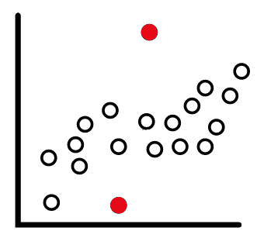
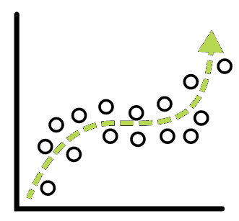
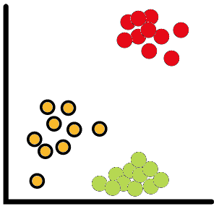
Splunk Customers Want Answers from their Data
Anomaly detection
Predictive Analytics
Clustering
Deviation from past behavior
Deviation from peers
(aka Multivariate AD or Cohesive AD)
Unusual change in features
ITSI MAD Anomaly Detection
Predict Service Health Score Predicting Churn
Predicting Events
Trend Forecasting
Detecting influencing entities
Early warning of failure – predictive maintenance
Identify peer groups
Event Correlation
Reduce alert noise
Behavioral Analytics
ITSI Event Analytics
Notes:
What’s a 7 minute conversation I can have with customers about Machine Learning across our product portfolio?
Remember, this is already recorded on Splunk E learning so you can always listen to this short presentation again.
Splunk Customers want Answers from their Data
At 50,000 feet there are three main categories of answers Splunk customers are often looking for. Maybe some of these are of interest to you.
Finding Anomalies in your data – for example deviations from past behavior or from peer groups of things like similar hosts or users. Splunk has built anomaly detection workflows for IT metrics in our ITSI product, I will be highlighting that in detail in a few slides.
Another common use of Machine Learning in Splunk is to forecast or predict the future – specifically based on what is happening right now in your process (be that business ,IT or security related) . Many splunk customers are interested in understanding what is likely going to happen in the near future and take preventative action.
Sometimes you don’t know what you are looking for – you don’t have a ground truth , you just want to find behaviors in your data and understand if they are similar or different from all other behaviors. When you are lost in the dense fog of IT alerts you might want to use machine learning to part lift the fog and focus on triaging the rare or common root causes in that moment – ITSI has packaged machine learning built for that as well.

Slide 7


Overview of ML at Splunk
CORE PLATFORM SEARCH
PACKAGED PREMIUM SOLUTIONS
MACHINE LEARNING TOOLKIT
Platform for Operational Intelligence

Slide 8

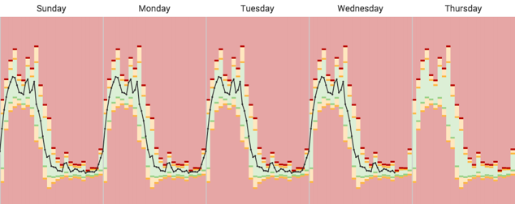
Adaptive Thresholding:
Learn baselines & dynamic thresholds
Alert & act on deviations
Manage for 1000s of KPIs & entities
Stdev/Avg, Quartile/Median, Range
Anomaly Detection:
Find “hiccups” in expected patterns
Catches deviations beyond thresholds
Advanced proprietary algorithms
Notes:
Splunk offers a premium app , IT Service Intelligence or ITSI , for the IT user. ITSI has a number of machine learning workflows built in – no data scientist required – your IT professionals load onto the train the services and metrics that affect your business and throw a switch for smart anomaly detection, in two pathways.
Adaptive Thresholding learns baselines and creates dynamic thresholds from the data – customizable by your IT professional – to alert and act on deviations on real time data.
Anomaly Detection, a Splunk proprietary time series algorithm, is controlled via an on/off button and find deviations in expected patterns of behavior – patterns that would not be caught by thresholds. These anomalies power workflows in ITSI to deliver outcomes for your IT professionals - uncovering the hidden fluctuations in key IT metrics your business relies on .

Slide 9
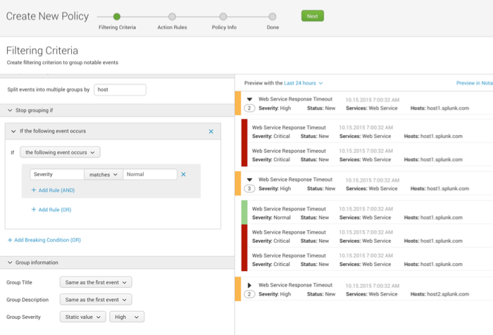
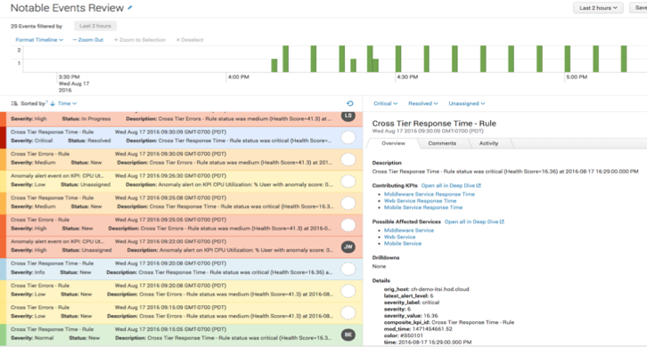
Event Analytics:
Prioritize event insights with service context, logs & metrics
Group related events to highlight the most meaningful ones
Reduce noise and alert on root causes of issues
Use ML algorithms to group similar events (Smart Mode)
Notes:
ITSI also has an Event Analytics workflow for prioritizing event insights, clustering the related events and clearing away the fog of war from your IT battle rooms.
If you are interested in ITSI’s ML workflows and how they would be valuable to your IT department, we should schedule an ITSI demo. There are several references on our website as well.

Slide 10

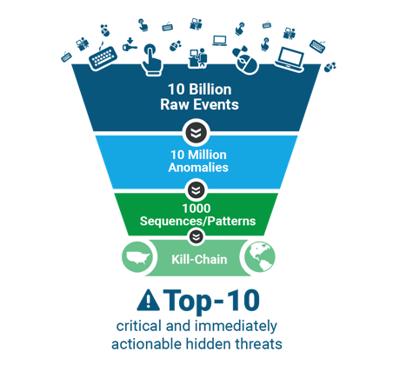
Packaged ML used for security anomaly detection, insider threats and more
Understand normal & anomalous behaviors for ALL users
UBA detects Advanced Cyberattacks & Malicious Insider Threats
Lots of ML under the hood:
Behavior Baselining & Modeling
Anomaly Detection (30+ models)
Advanced Threat Detection
E.g., Data Exfil Threat:
“Saw this strange login & data transfer for user mpittman at 3am in China…”
Surface threat to SOC Analysts
Notes:
Splunk also offers a packaged ML security app , User Behavior Analytics, for anomaly detection, insider threats and more. UBA does not require a data scientist, but does have an SDK if you do have a data science team interested in customizing your copy of UBA. UBA is about transforming the billions of raw events that splunk ingests for your security team into anomalies and then refining those anomalies into threats for your SOC team.
If you are interested in UBA and understanding the outcomes it drives, we should schedule a deep dive on that product with the regional Splunk security SME. There are several references on our website as well.

Slide 11
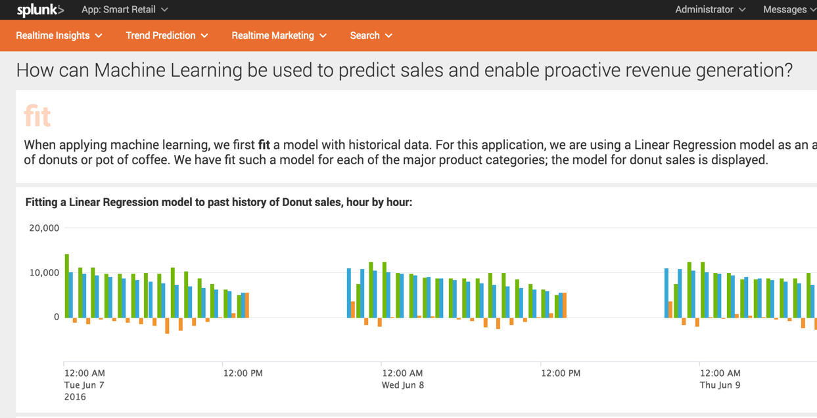
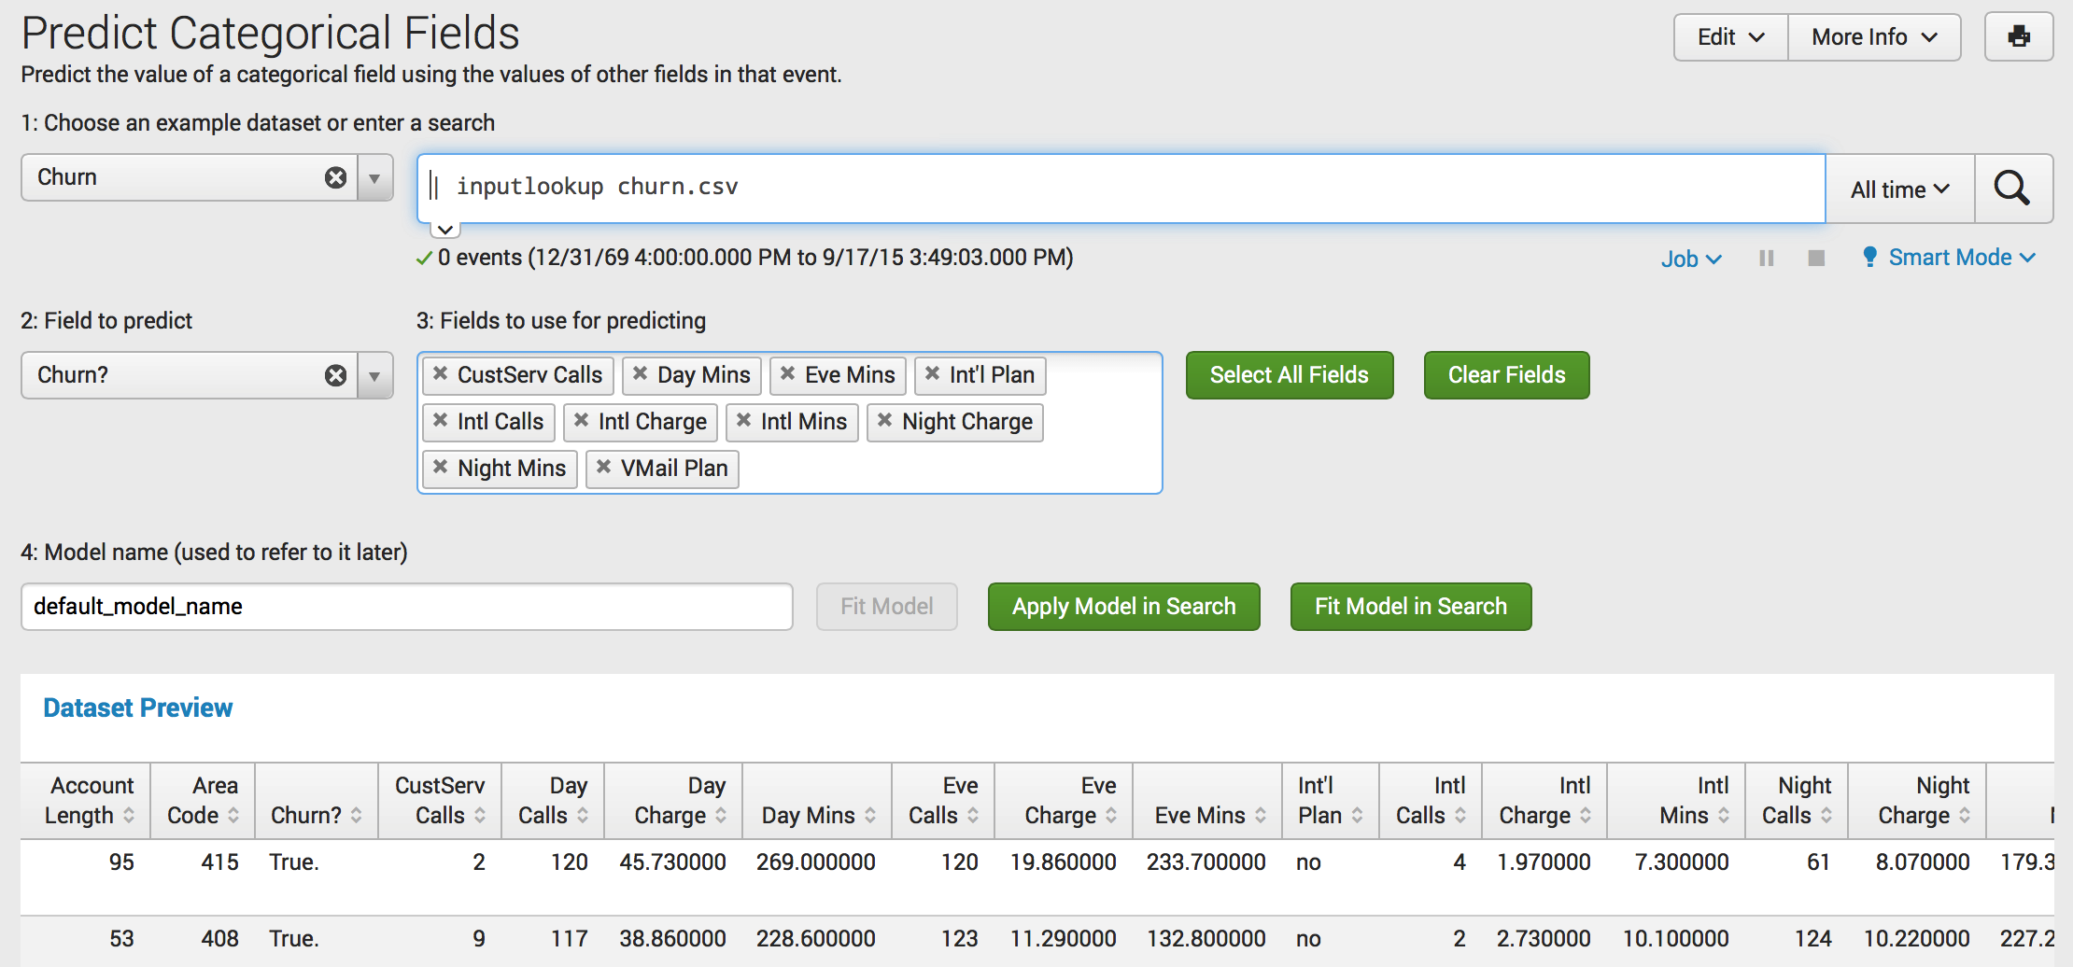
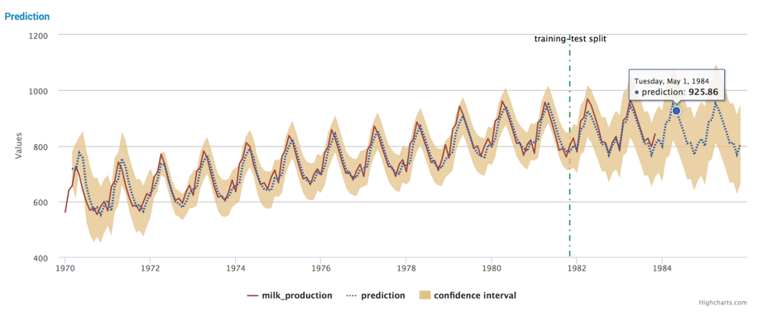
Splunk Machine Learning Toolkit (MLTK)
Extends Splunk platform functions and provides a guided modeling environment
Assistants: Guided model building, testing and deployment for common objectives
Showcases: Interactive examples for typical IT, security, business and IoT use cases -
Algorithms: 30 standard algorithms (supervised & unsupervised)
ML Commands: New SPL commands to fit, test and operationalize models
ML-SPL API: Extensibility to easily import any algorithm (proprietary / open source)
Python for Scientific Computing Library: Access to 300+ open source algorithms
Spark MLLib: Support large scale model training via Spark Add-on for MLTK (Private-Beta)
Build custom analytics for any use case
Notes:
Finally we have Splunk’s machine learning toolkit, a free app with guided and easy to use Assistants (query builders) that walk you through the process of using machine learning for any custom use case. This is a box of Legos designed to empower the Citizen Data Scientists of the world, operationalizing machine learning for your custom use – allowing you to apply machine learning to real time data in splunk and take action.
The toolkit has a showcase with 30 or so examples based on sample data sets, videos walking you through each of the examples, and a number of visualizations for looking at large sets of data like the Down Sampled Line chart for showing millions of data points. We ship the toolkit with 30 or so pre wrapped algorithms, but the toolkit has an API for you to bring in any algorithm from Sci Kit Learn , Sci Py, or Statsmodel (extremely popular python machine learning libraires) or if you have proprietary algorithms you can bring those in as well. New in 2018 the MLTK will also be bridging to you Spark servers for large scale model building. The toolkit updates roundly every 8 weeks or so with new content.

Slide 12
Skill Areas for Machine Learning @ Splunk
Domain Expertise
(IT, Security…)
Identify use cases
Drive decisions
Understanding of business impact
Premium solutions provide out of the box ML capabilities.
ITSI, UBA
Splunk Expertise
Data Science Expertise
MLTK
Splunk ML Toolkit facilitates and simplifies via examples & guidance
Searching
Reporting
Alerting
Workflow
Statistics/math background
Algorith selection
Model building
Notes:
Splunk is very invested in Customer Success, and I want to be sure I have clarified what machine learning capabilities we have across our products for you to be successful with. To be clear, success with the Lego box of the MLTK (custom machine learning use cases) , requires three expertise types to be present - Domain Expertise for the problem you are solving, the Splunk Expertise for understanding how the platform works, and the data science expertise to select the appropriate algorithm. Our premium solutions provide out of the box ML capabilities without the need for data science expertise. Your Domain expertise and your splunk expertise are all that is required to immediately start working with ITSI and UBA.

Slide 13
Custom Machine Learning with the Splunk Platform
Ecosystem
Splunk’s App Ecosystem contains 1000’s of free add-ons for getting data in, applying structure and visualizing your data giving you faster time to value.
MLTK
The Machine Learning Toolkit delivers new SPL commands, custom visualizations, assistants, and examples to explore a variety of ml concepts.
Splunk
Splunk Enterprise is the mission-critical platform for indexing, searching, analyzing, alerting and visualizing machine data.
Operationalized Data Science Pipeline
Collect
Data
Clean &
Munge
Search & Explore
Pre-processing
Feature Selection
Choose Algorithm
Build, Test, Improve Models
Operationalize Monitor Alert
Visualize &
Share
Ecosystem
Ecosystem
Splunk
MLTK
MLTK
MLTK
MLTK
Ecosystem
Splunk
Splunk
Splunk
Splunk
Splunk
Splunk
Splunk

Slide 14
Exploratory Data Analysis
Utilizing the Splunk platform for data science

Slide 15
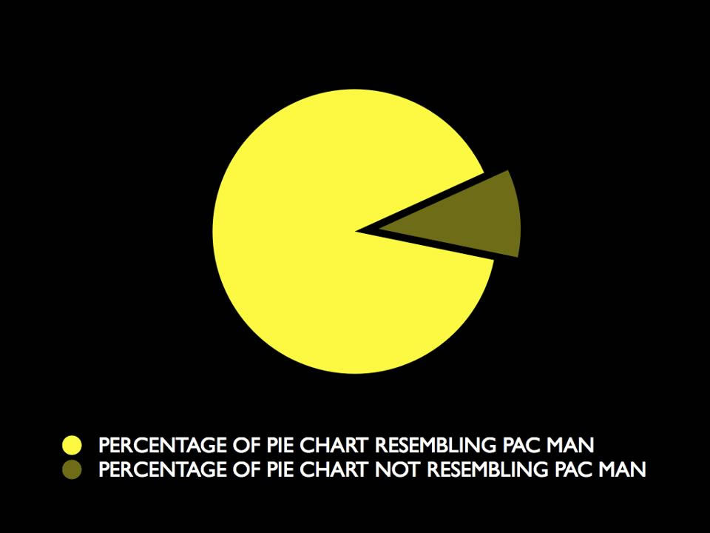
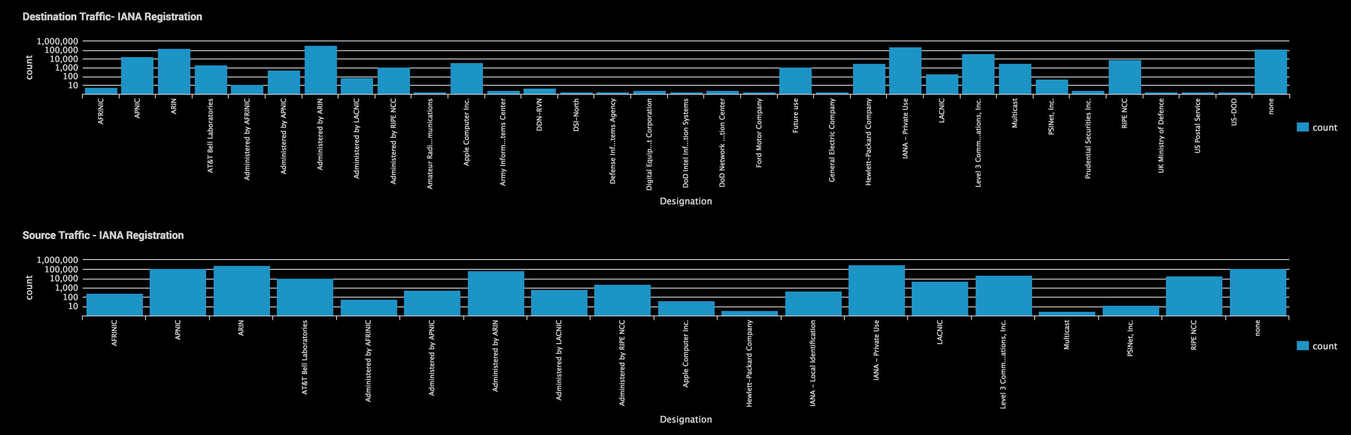
Visualization & Creating Context (EDA)
Visualization is a powerful EDA tool
Not everything can be described as bits, bytes, plaintext or pie charts.
Correlation to add context to your data during the EDA process or test hypothesis.
Notes:
We can also use visualization as a tool for understanding and exploring our data. Not everything is useful in csv, excel, email. In this example I am looking at connection attempts and IANA registration. I can learn about the distribution of data and start to formulate new questions about botnets operating from those networks. Su

Slide 16
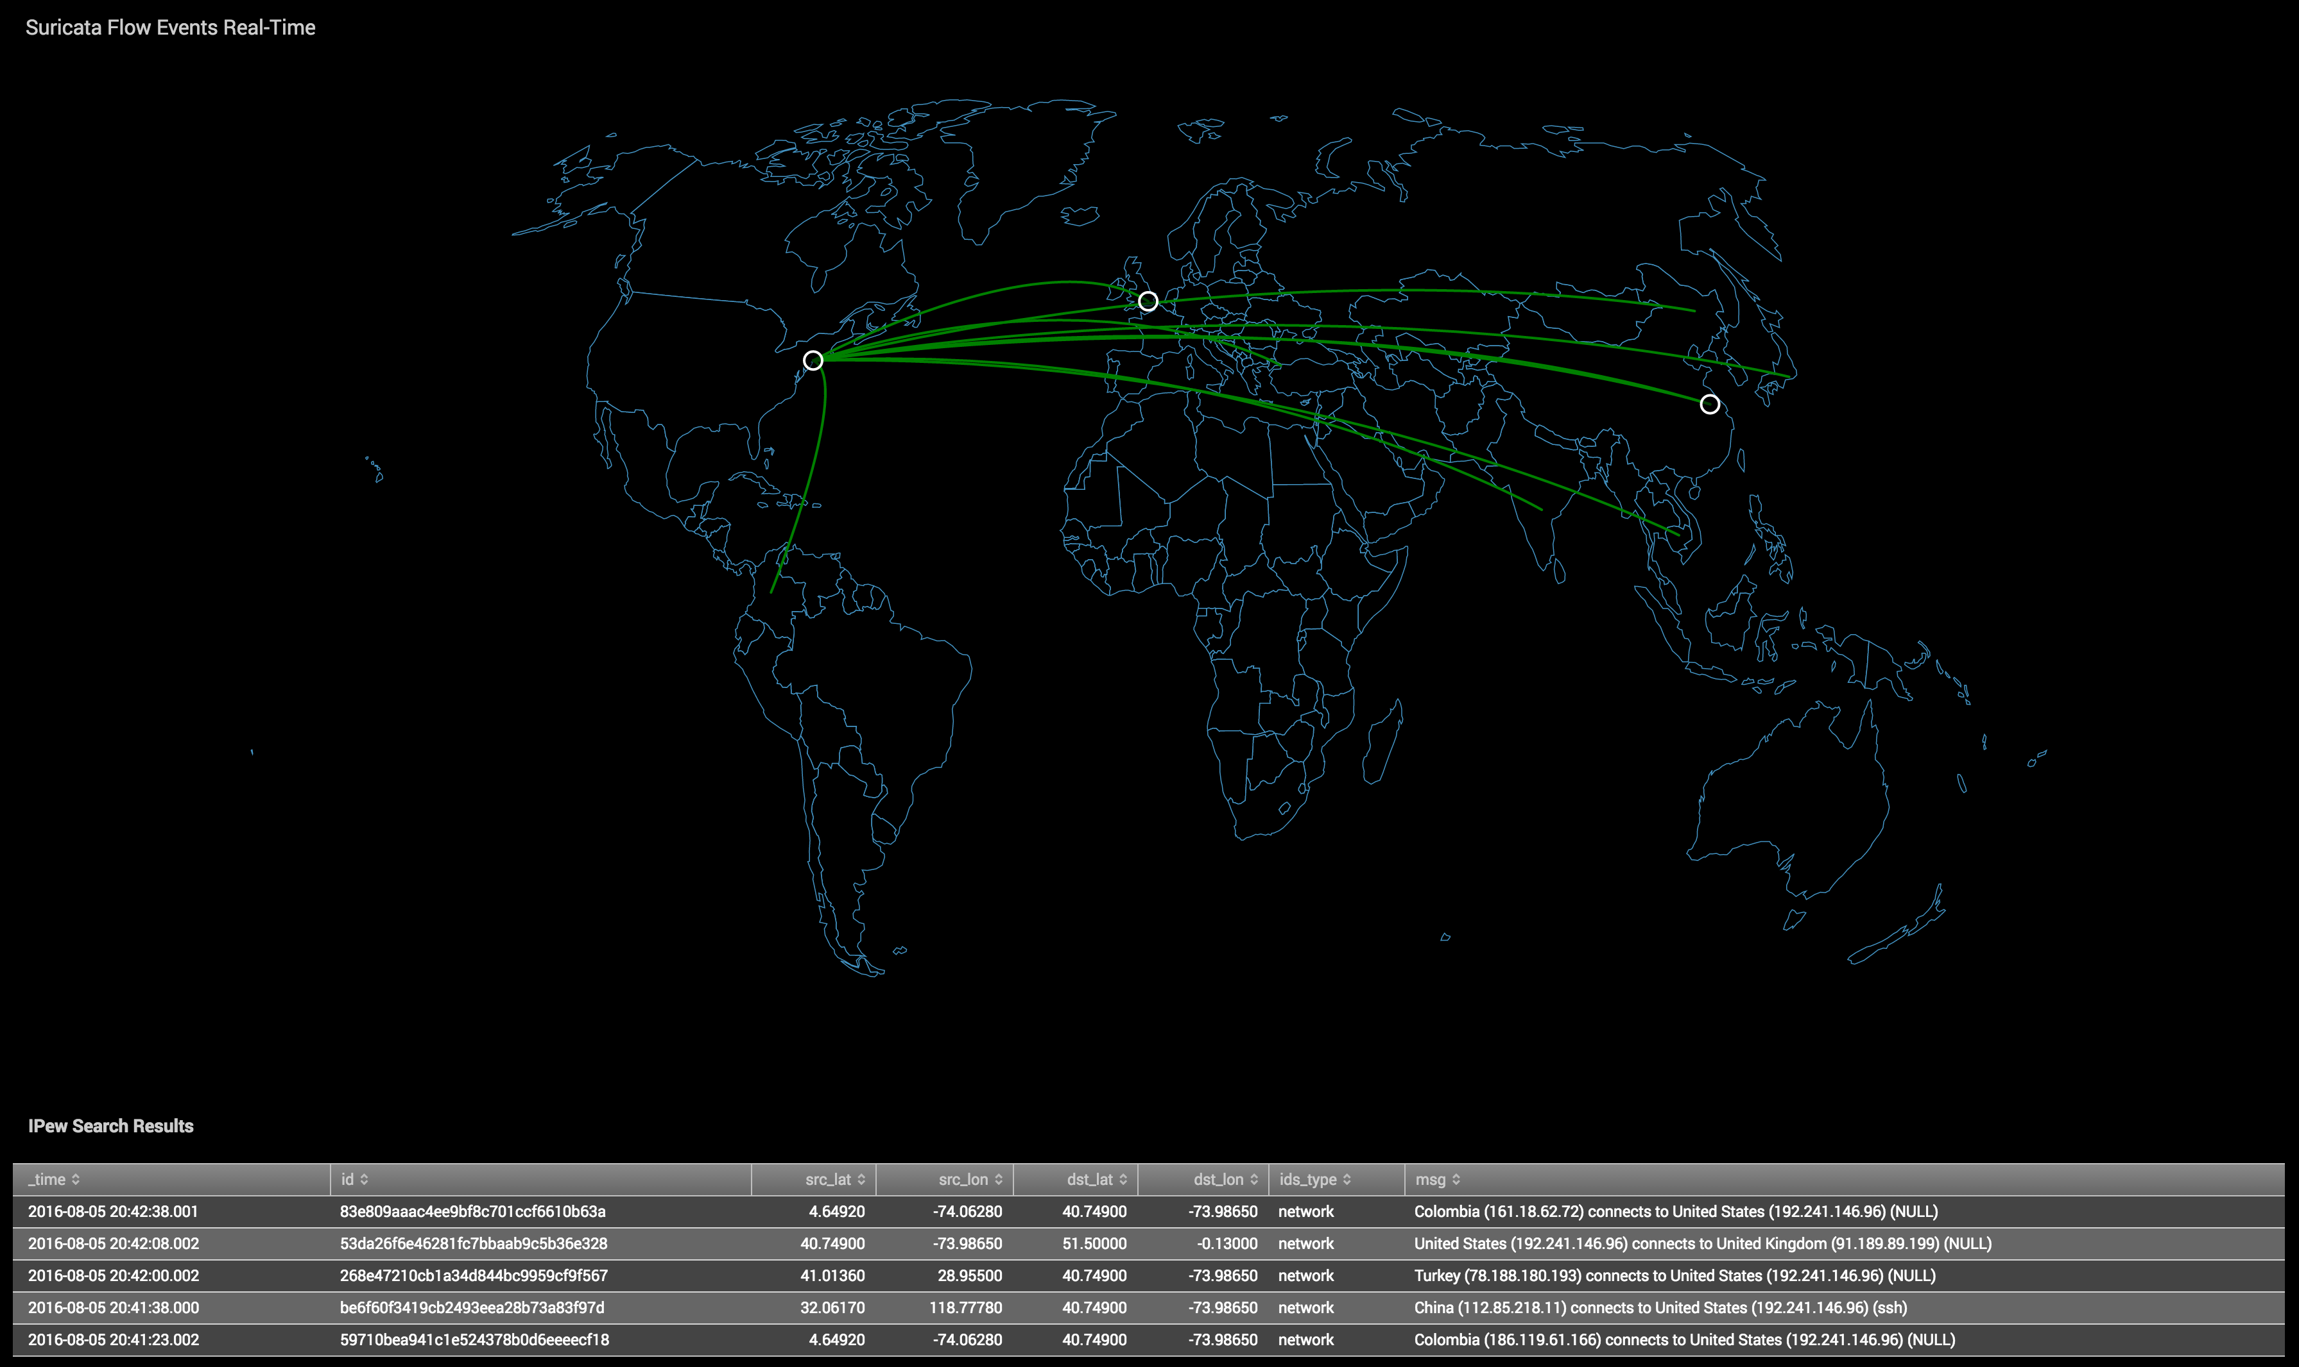
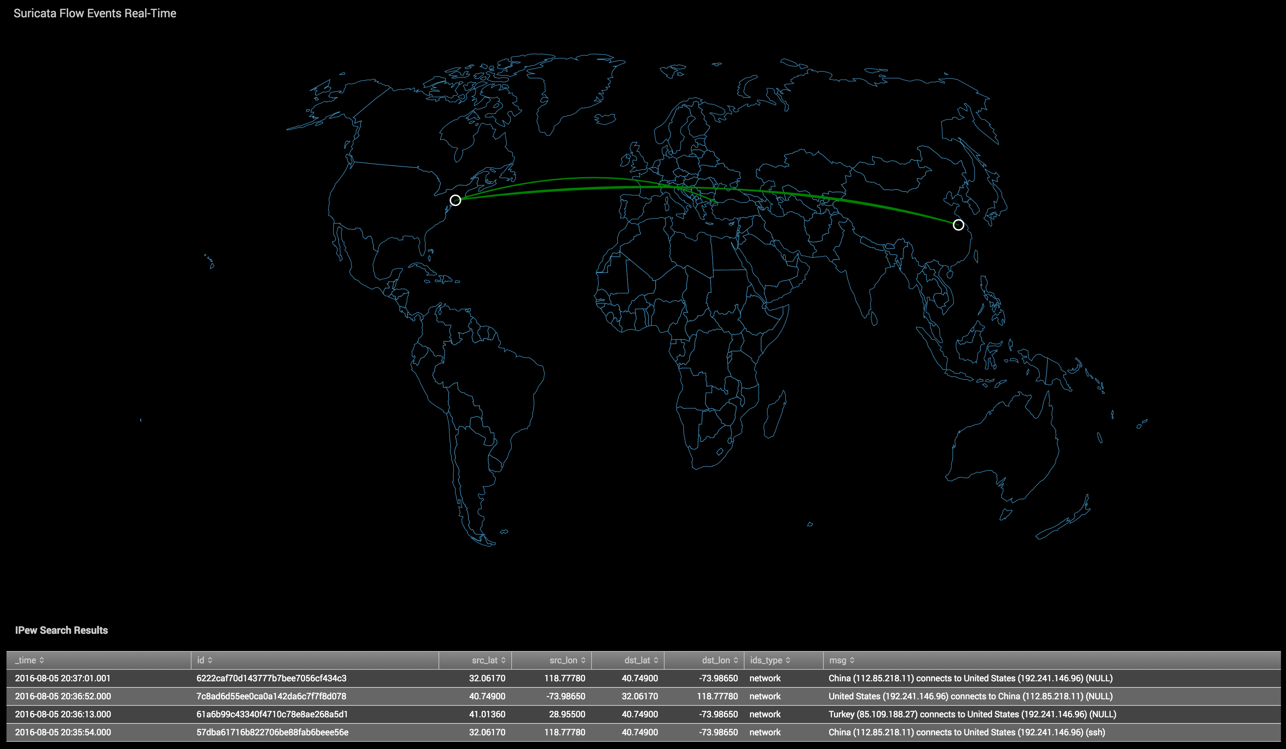
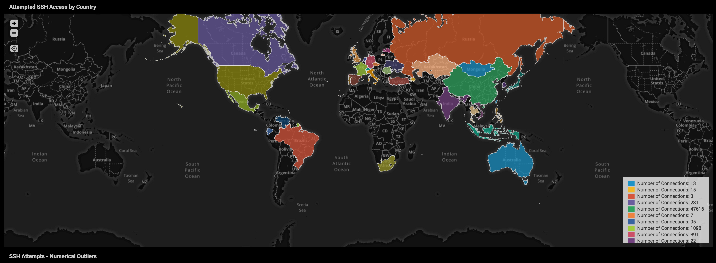
Geographical EDA - Visualization
Visualization useful for exploring multi-dimensional relationships.
Tells a story about the data you can’t describe in text or tables.
“Where are connections ‘originating’, and how often am I seeing this activity?”
Notes:
I can also visualize using geographical data, geoip is powerful for conveying a narrative which is difficult to describe using only logs. This might provoke new questions about the sheer number of connections from cyber adversaries, or unexpected traffic from a market you don’t do business.

Slide 17
Hunting DGA Activity
DGA hunting using Shannon entropy

Slide 18



Practical Applications to DGA type activities
DNS Water Torture
Botnet sends queries with 16 letters randomly prepended to the victim’s domain.
xyuiasdfcosic.www.halpme.com
alkdfejenjasd.www.halpme.com
C&C Beaconing Activity (Dynamic DNS)
Advanced malware uses a Domain Generation Algorithm (Random Subdomain)
d0290d00xasdf.no-ip[.]org
Data Exfiltration
DNS Tunneling (Query)
dnscat.912701a98e9bde415c4ad70007beaf54d2
dnscat.925401a98ebe0cf540b20d001a4b5e726494b001bb4c192bb68fe73c000bf7c1c0e
Two Techniques to detect this activity in Suricata:
Shannon Entropy of DNS Query, HTTP destination
Character Length of DNS Query, HTTP destination
Notes:
You’re probably thinking, yeah those visuals are pretty great for non-security people, but how do I operationalize any of this to increase my security posture? The great thing about an analytics platform is it provides you the tools to look historically at your data and search for behaviors signature based systems may have missed. The platform provides you the opportunity to search for signatures that might be unique to a new ransomware campaign or data exfiltration by insiders by making use of mathematical calculations you cannot compute in real-time on a sensor on a per packet basis.

Slide 19
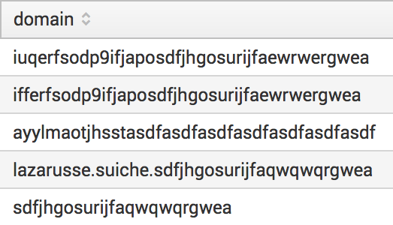
Domain Generating Algorithms (DGA)
What’s the problem?
Challenges to detect DGAs:
Static matching runs against potentially infinite blacklist entries O(∞)
Regex can narrow down this list, but still hard to compute and find rules (and define exceptions for rules)
Unknown unknowns?
Want to get fuzzy?
Good use case for ML!
Example of DGAs:
Example IoCs for Wannacry (https://cert.europa.eu/static/SecurityAdvisories/2017/CERT-EU-SA2017-012.pdf)

Slide 20
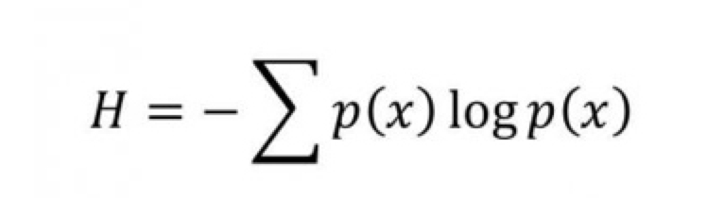
Shannon Entropy for DGA Hunting
What is Shannon Entropy?
“… a measure of uncertainty in a random variable”
How does it help us find malware and anomalous activity?
The more random a string is, the higher its calculation of randomness.
aaaaa.com (Score 1.8)
Google.com (Score 2.6)
Ic49f66b73141b5c1.com (Score 4.1)
Domains and subdomains with high entropy are good indicators of malicious behavior.
We can filter to domains or subdomains with a score above 3 or 4.
Cons:
False positives
CDNs like Amazon, Akamai, and others use pseudorandom generated subdomains
Requires to you to keep a blacklist or whitelist of domains to reduce noise when hunting (but, relatively easy to do in Splunk)
Malware evolves
Locky & others using shorter subdomains or domains to reduce randomness, reducing entropy score
Notes:
There are numerous ransomware campaigns such as Locky, EK Neutrino and Angler which make use of high entropy subdomains and domains as part of the command & control process.

Slide 21
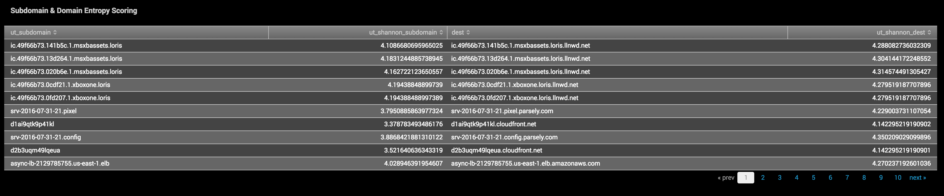
Shannon Entropy for DGA Hunting
# Results of Suricata HTTP Entropy Scoring
Python Lookups - Entropy Analysis of DNS / HTTP
# Full Query for Suricata HTTP
index=suricata host=suricata event_type=http | lookup ut_parse_extended_lookup url AS dest | lookup ut_shannon_lookup word AS ut_subdomain OUTPUT ut_shannon AS ut_shannon_subdomain | lookup ut_shannon_lookup word AS dest OUTPUT ut_shannon AS ut_shannon_dest | search ut_shannon_dest > 4 OR ut_shannon_subdomain > 4 | table ut_subdomain ut_shannon_subdomain dest ut_shannon_dest | dedup dest ut_subdomain
Notes:
He’s an example of a search for high entropy subdomains & domains in Suricata http logs.

Slide 22
Machine Learning & Security Analytics
DGA Domains & Mirai Botnet

Slide 23
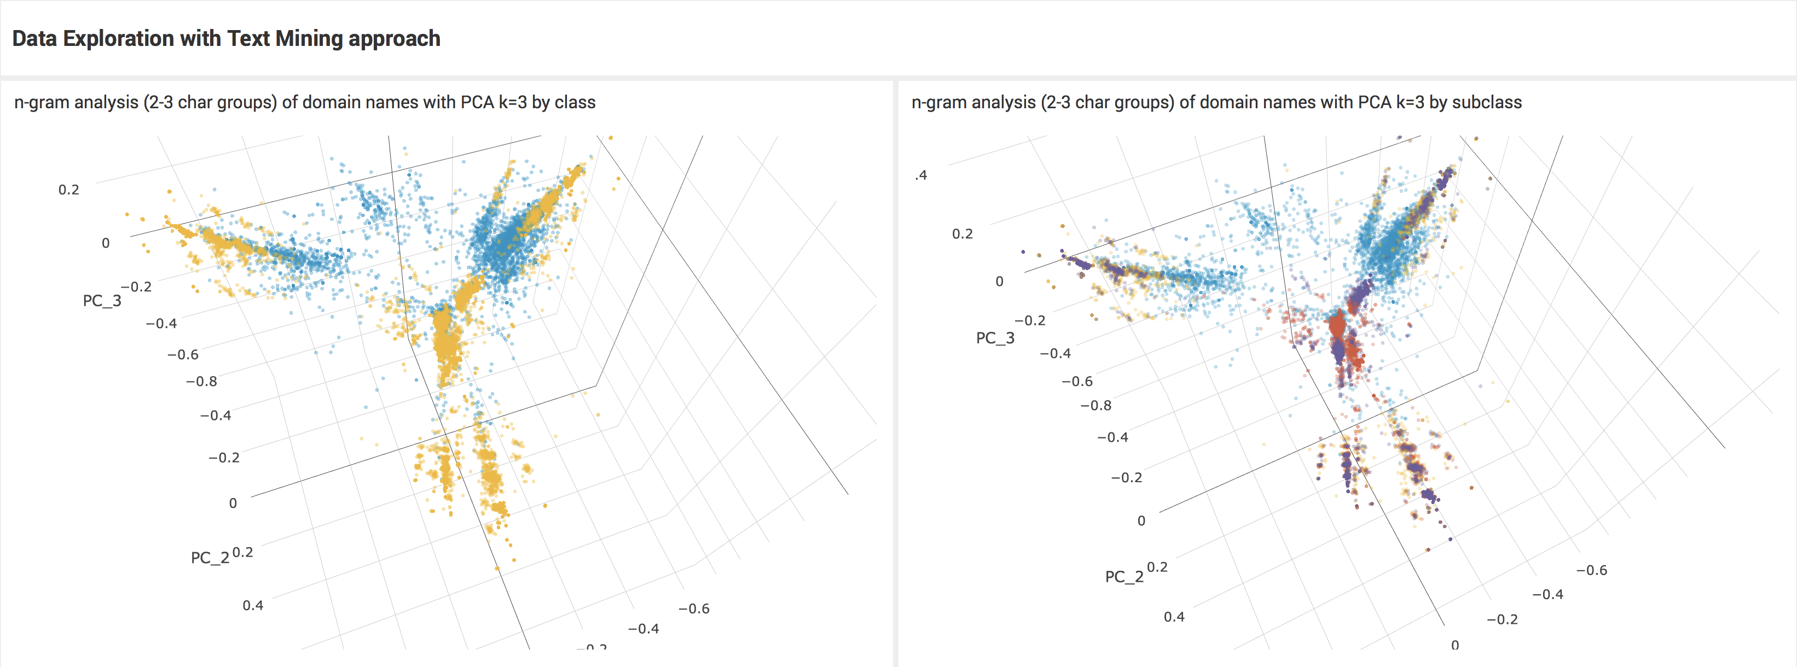
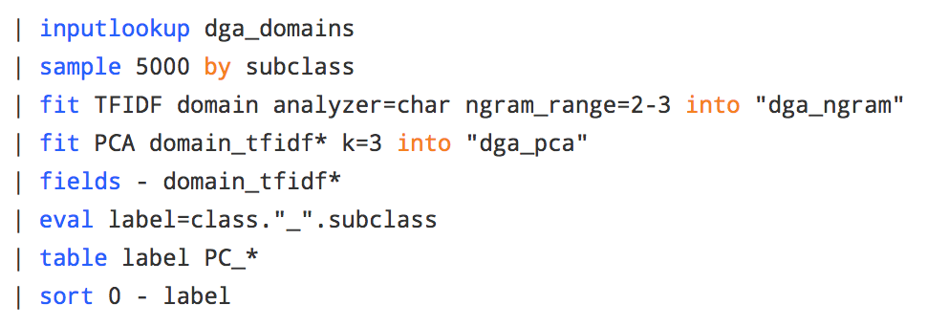

Slide 24
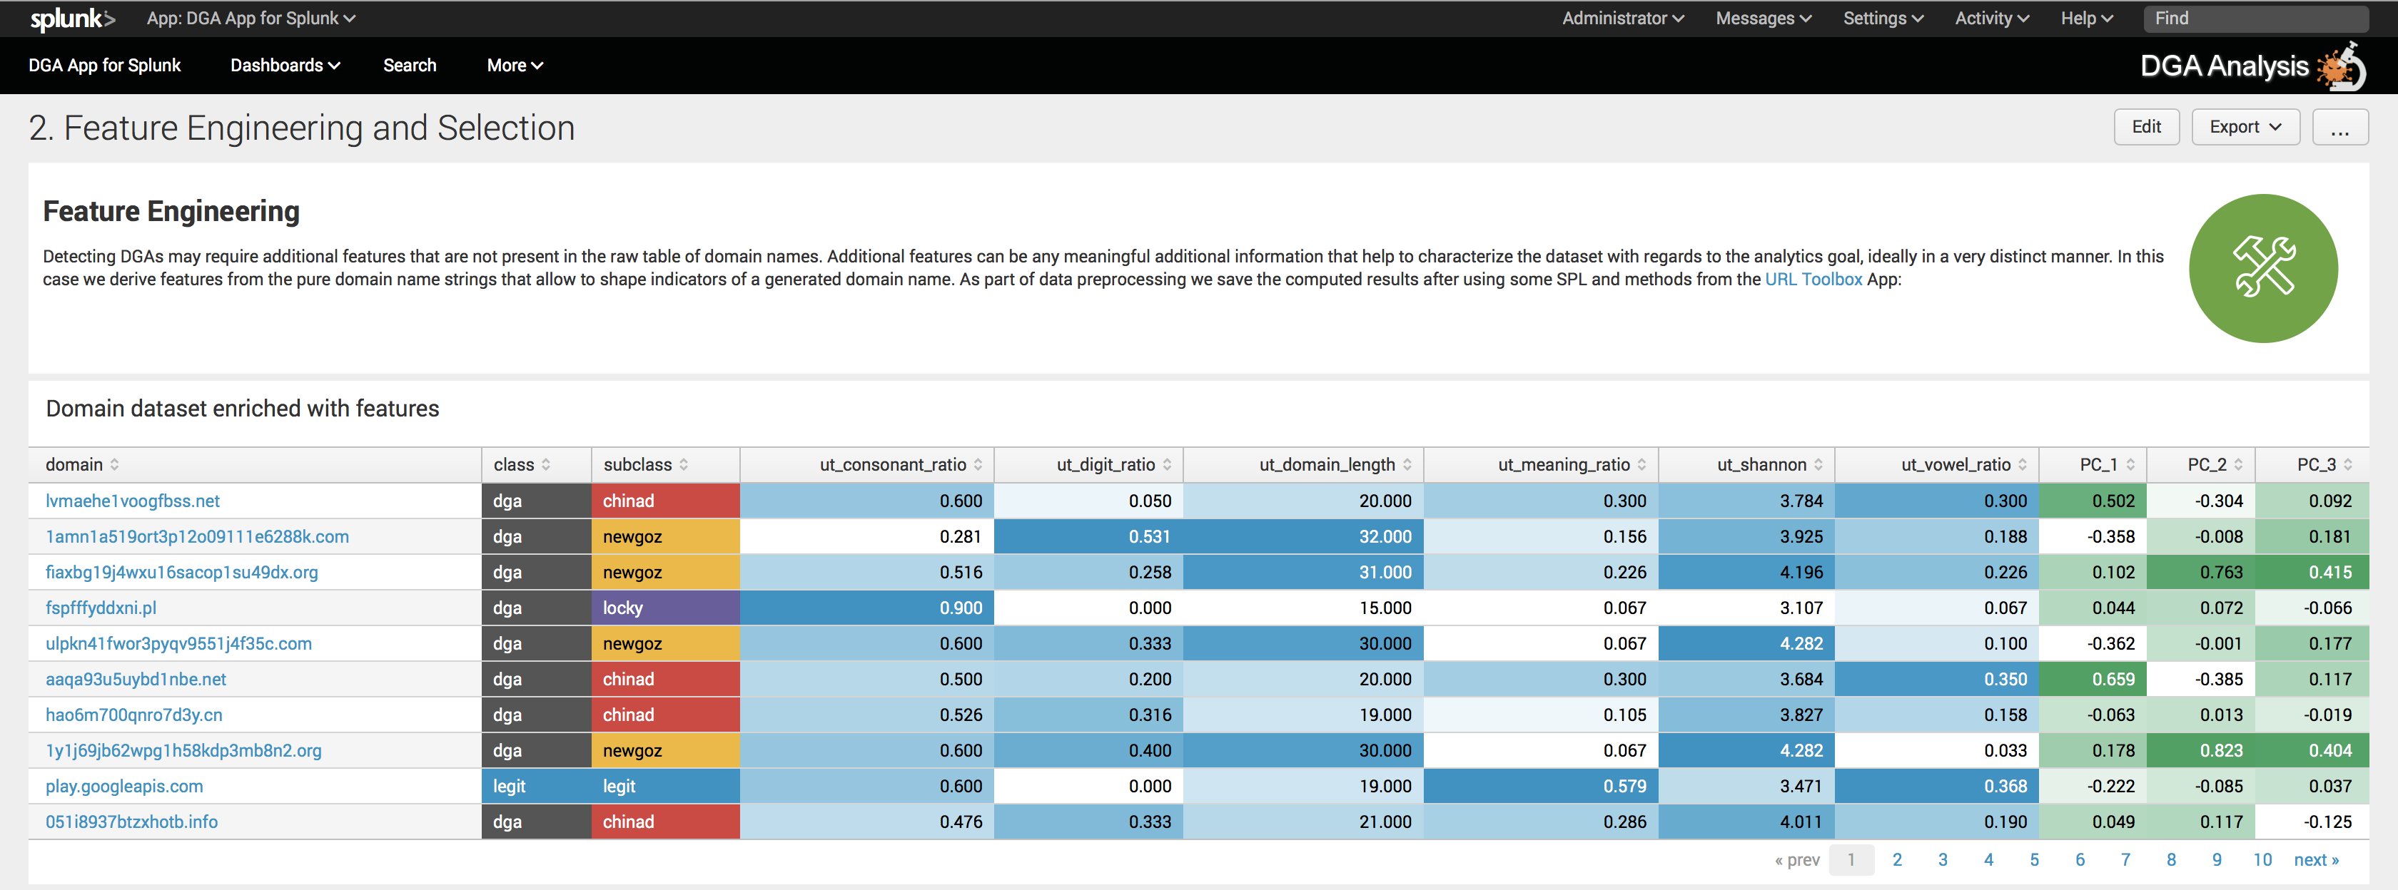
More features can significantly improve your machine learning models
Be wary of overfitting!
Extensible feature engineering ideas
(e.g. subdomains, age of domain registration, rating/scoring from threatlists for known malicious domains etc.)

Slide 25
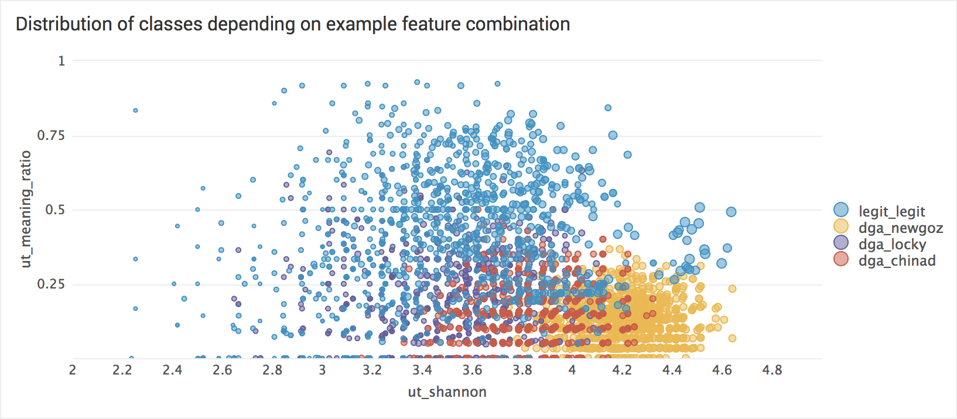
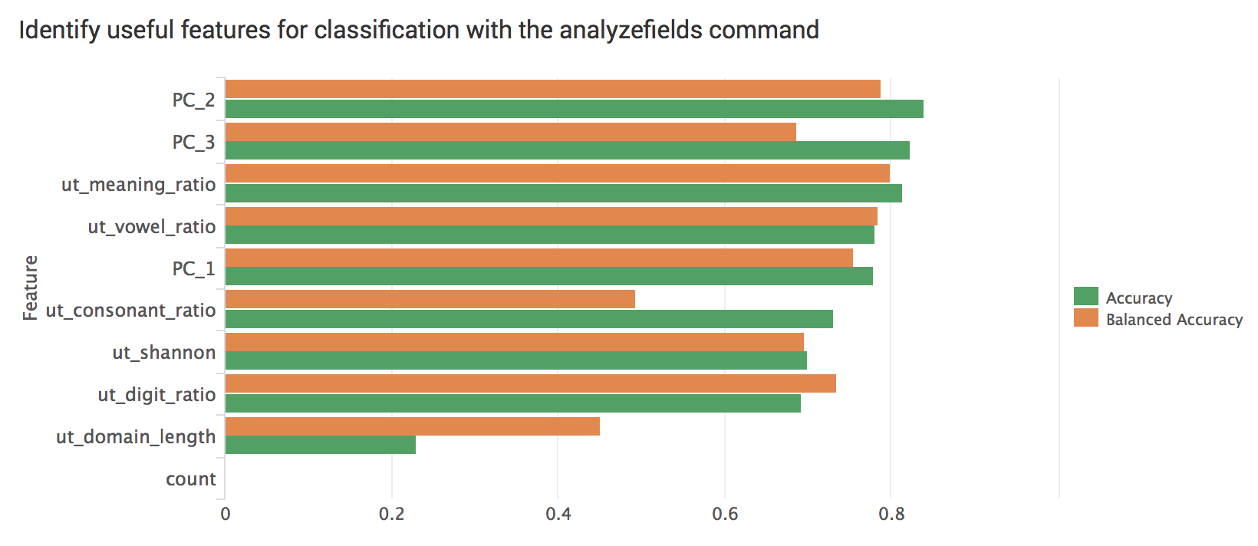
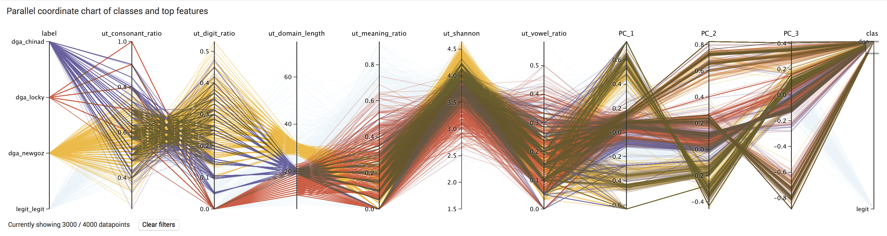
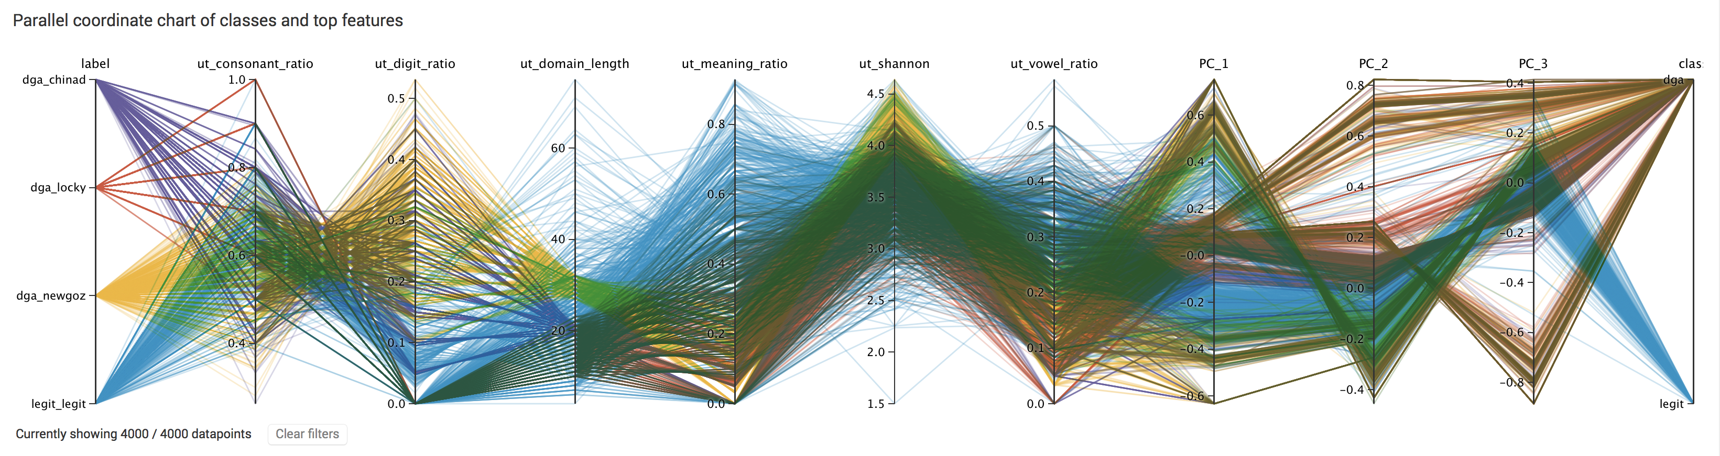

Slide 26
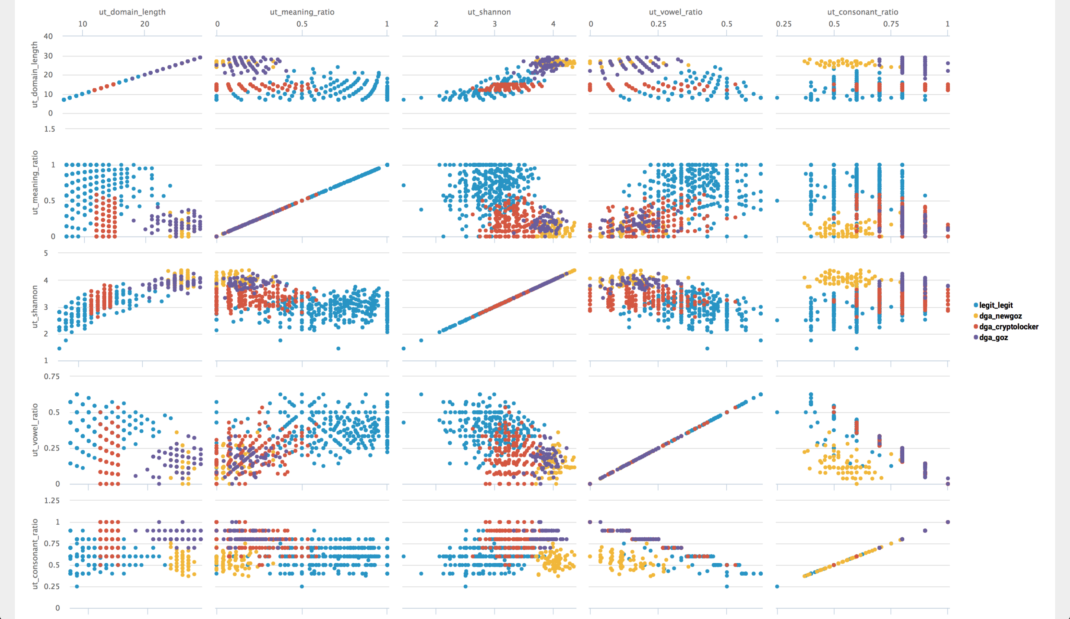

Slide 27
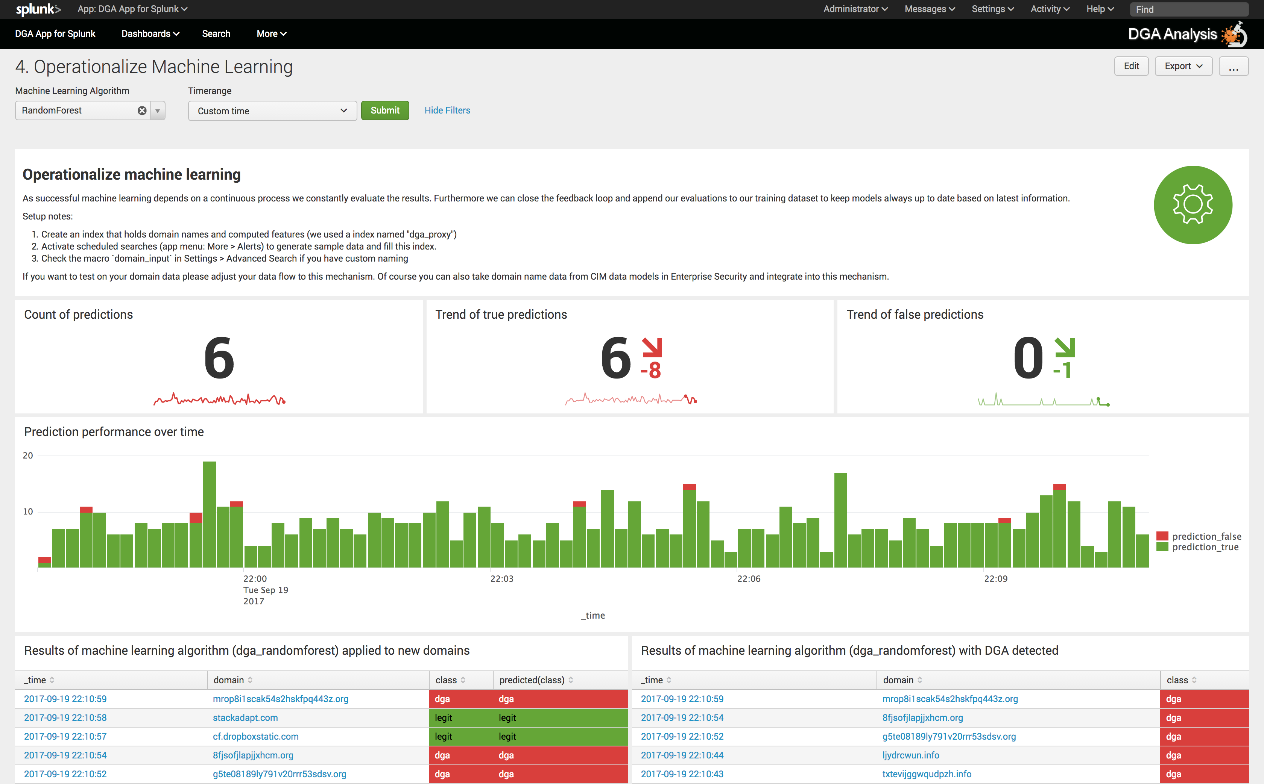

Slide 28
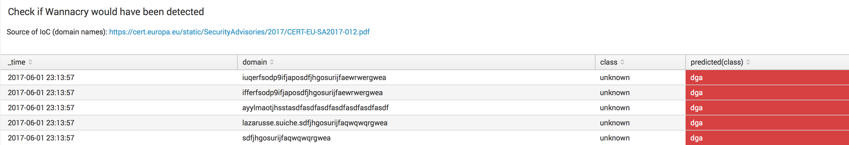
Reality check: Detect Unknown Unknowns?
Example WannaCry
Check how our trained model performs against WannaCry C&C domains that the model has NOT been trained on.
Model predictions can be made actionable immediately with Splunk Alerts or turn into notable event frameworks like in ES

Slide 29
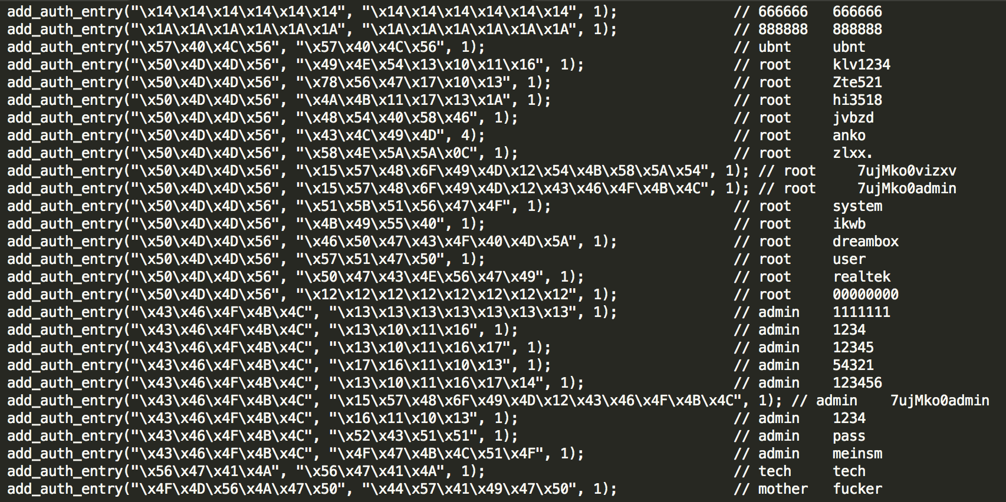
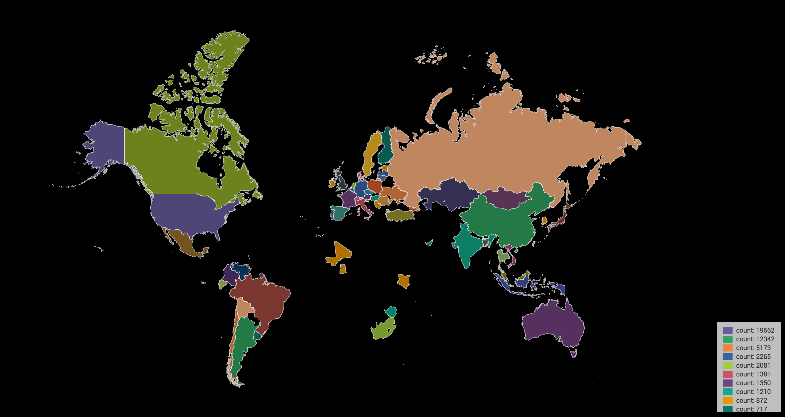

Correlation – Finding Mirai
Technique
Default credentials hard-coded in the Scanner.C module give us a behavioral signature to look for.
Telnet/SSH attempts using invalid users (tech, mother, ubnt, 666666, 888888) are unique to Mirai, & other botnets (post source code leak).
Correlate list of IPs with Suricata to find other activity from these IoT nodes attempting to breach my network.
Mirai Scanner.C module
Notes:
Mirai botnet, was the largest DDoS in recorded history when it attacked Brian Krebs blog with nearly 620GB/s of traffic from compromised IoT devices. Mirai beat that record later when it trashed DynDNS with a 1.2TB/s attack causing havoc on the East Coast. Prior to the DynDNS attack the source code was leaked likely in an effort to cover the tracks of the creator, giving security researchers a glimpse into the capabilities of Mirai.

Slide 30
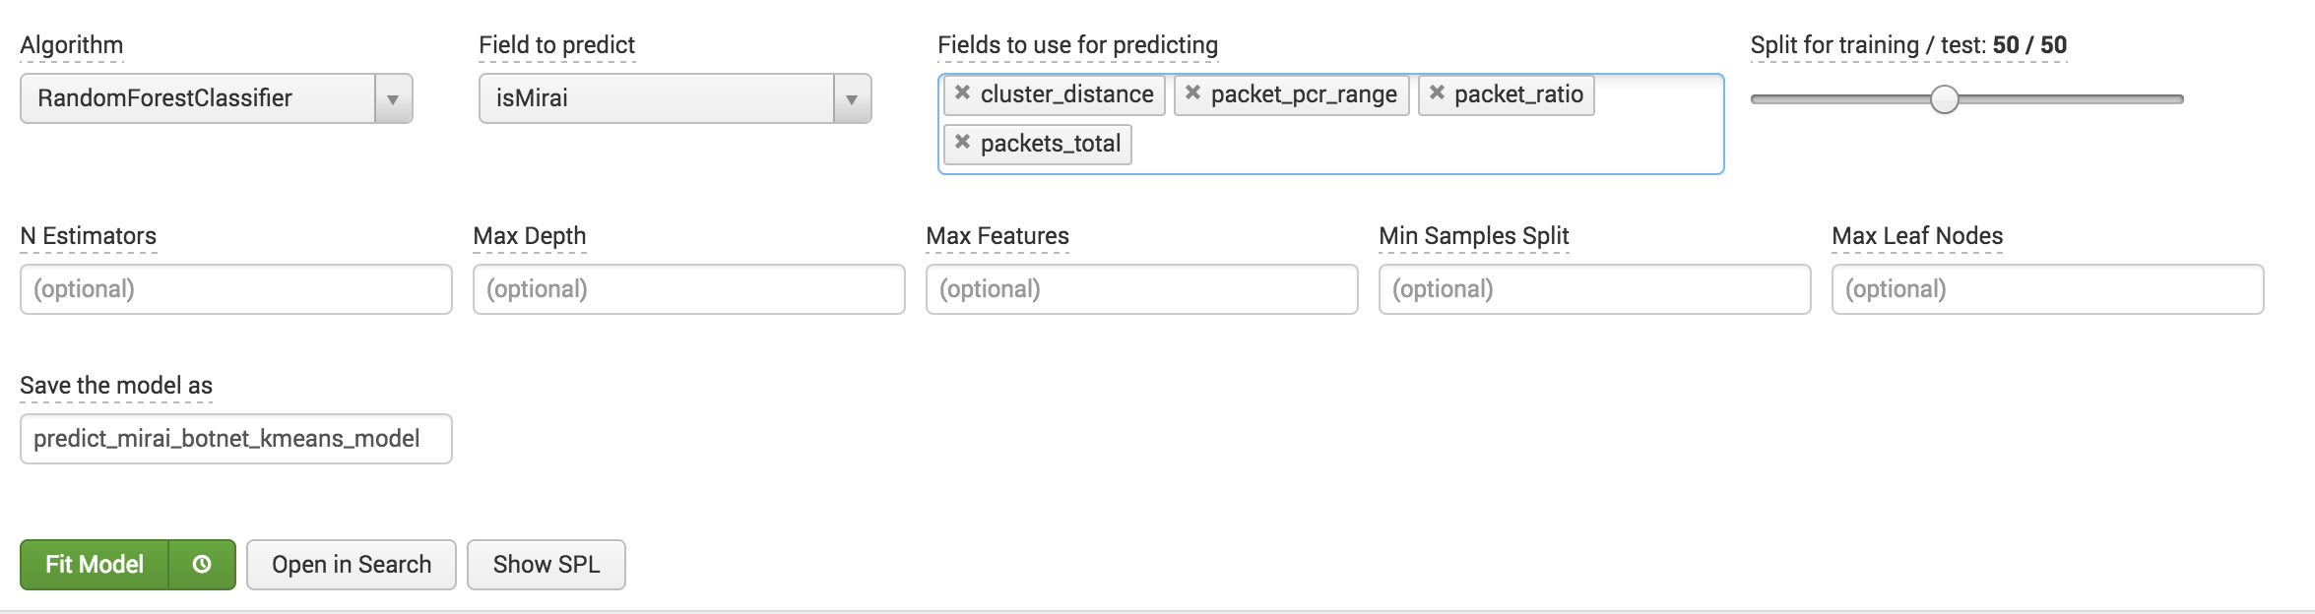
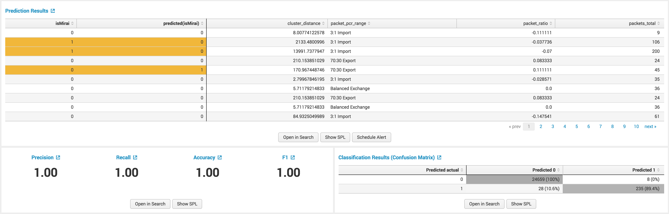
Machine Learning- Predict Mirai
Random Forest
Results
High precision at predicting 0
Small false positive (8/25,000)
10.6% False Negatives
89.4% Correct at getting Mirai Traffic correct
Summary
IPS sensor allowed all of these connections (Not Blocked), while we missed 10.6%
We now have a model which we can further refine to identify malicious SSH traffic to investigate.
Adds a new layer to our security stack

Slide 31
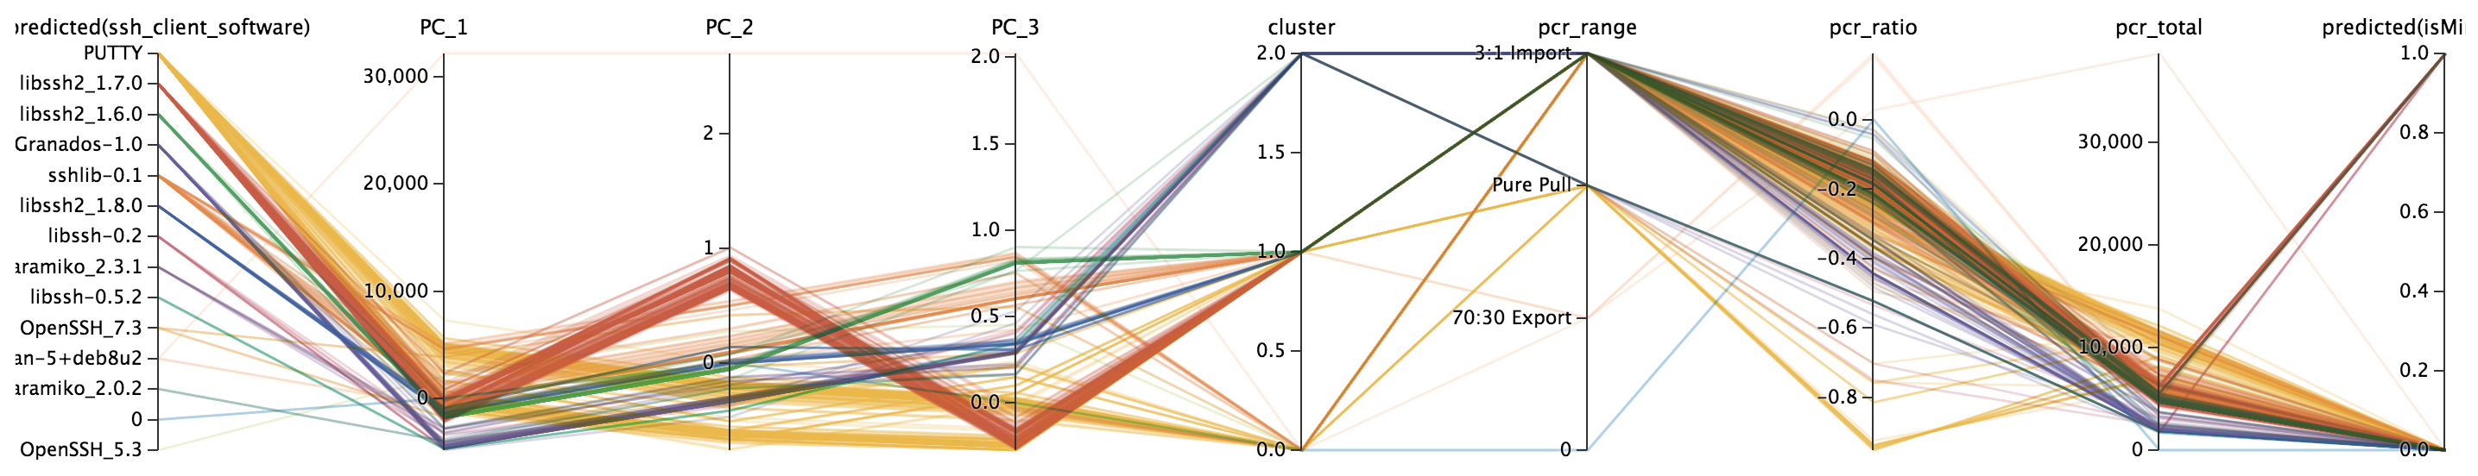
Labeled Mirai Traffic
Create a model using labeled Mirai traffic
Apply the mirai model to ssh data
| apply "pcr_rnd_mirai”
Use PCA & Kmeans to reduce features of SSH connections
Operationalize model at the IPS/IDS level to alert for specific conditions
Operationalize model in Splunk for adaptive response: Block IP that meets condition

Slide 32
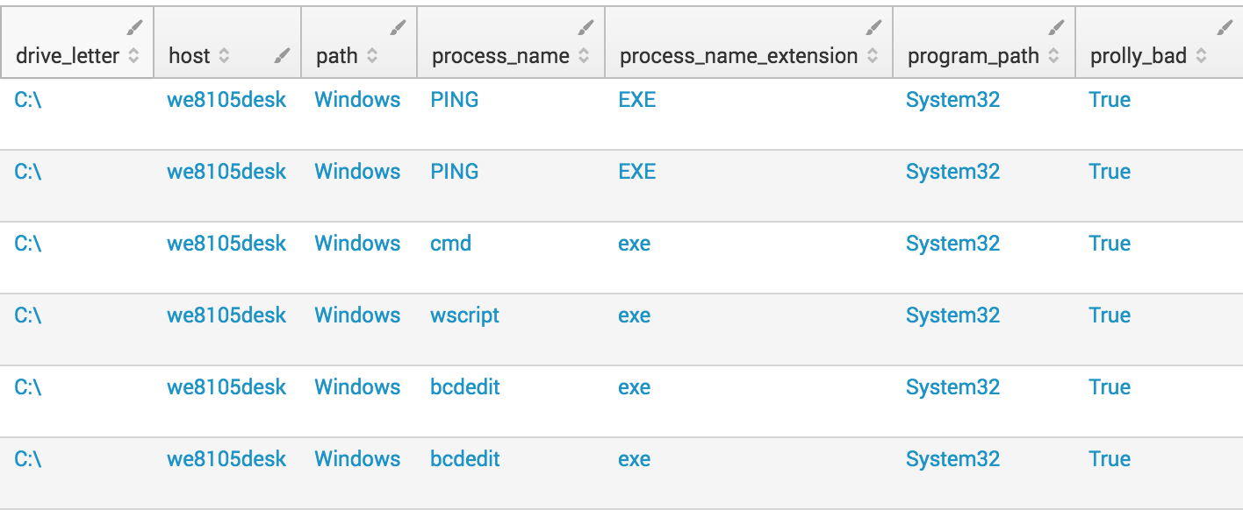
Using MLTK for CLI execution
Getting more from Windows Event logs
The machine learning toolkit can be used to engineer features to detect deviations from normal baselines or anomalous processes.

Slide 33
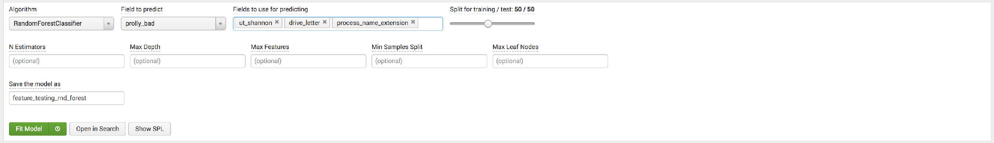
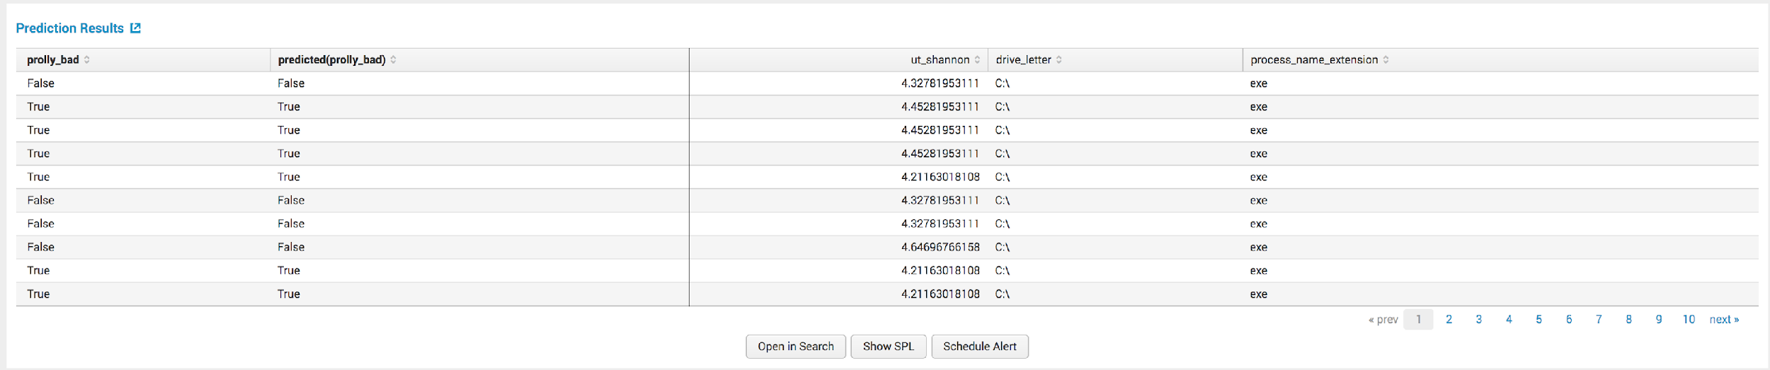
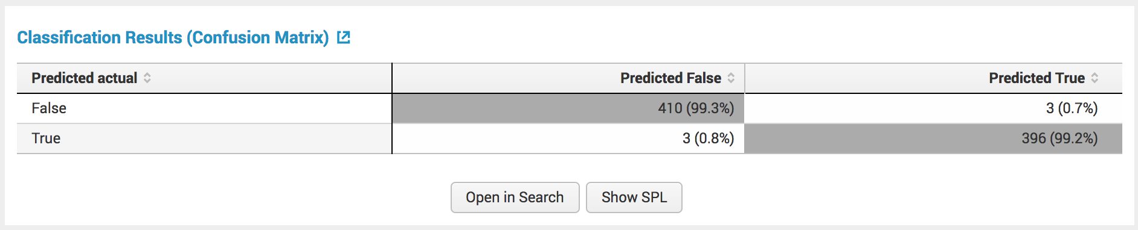
Using MLTK for CLI execution
Example
MLTK provides a simple interface for creating complex experiments and testing against live or historical data

Slide 34

MLTK is a Bridge

Slide 35

2017 MLTK is a bridge to Python for Scientific Computing and Custom ML
MACHINE LEARNING TOOLKIT

Slide 36

2018 MLTK is a bridge to Spark MLIB
MACHINE LEARNING TOOLKIT

Slide 37
Customer Stories

Slide 38



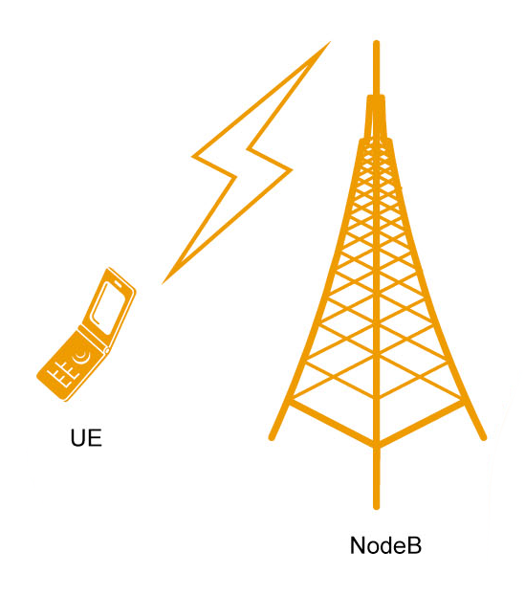
Acting on a Critical Customer Outages before the Customer Calls You
ML Success Stories
Consumer Credit Reporting Agency
Many different machines are part of the drug discovery process, and machines acting abnormally mean a loss in efficiency and increased costs.
Detect interference in cell towers
Reconfigure underperforming cells for optimal services levels
Improving cell tower uptime and reducing repair truck rolls with anomaly detection and root cause analysis

Slide 39



Failed orders detected in real time to avoid lost revenue and unhappy customers
ML Success Stories
Entertainment Company
Find errors in server pools, then prioritize actions and associate root cause
Predicting and averting potential gaming outage conditions with finer-grained detection
Preventing fraud by Identifying malicious accounts and suspicious activities
Predicting Student Achievement and taking action to improve grades
Online Retailer
Detecting Data Quality and taking action to support data dependent business processes

